Slide 1
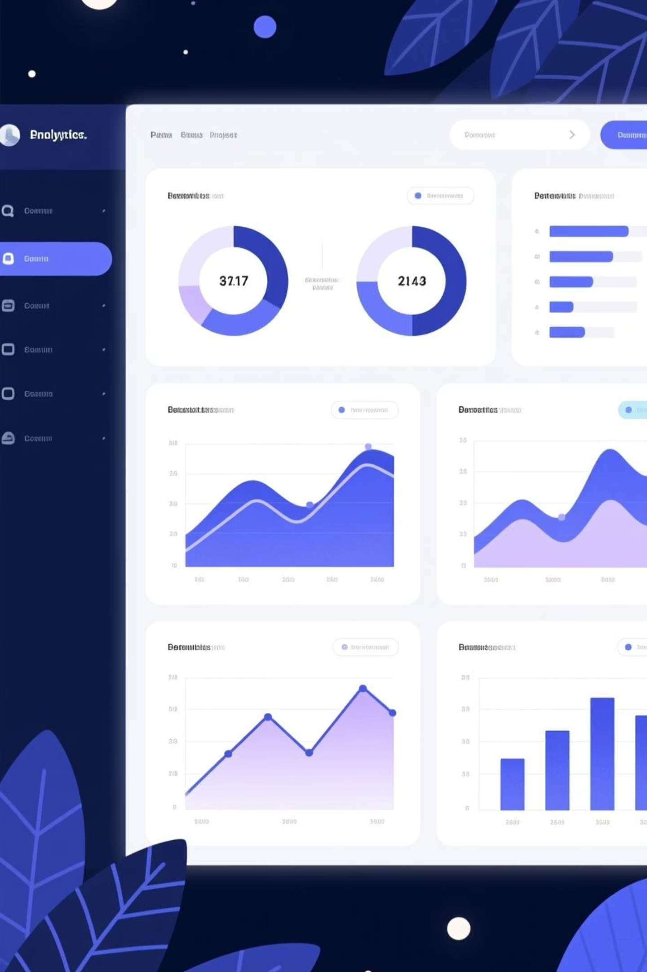
Customer Segmentation & Shopping Trends Analysis
Data Analytics Project
SQL | Power BI

Slide 2

Project Overview & Business Value
Project Objectives
Analyze customer shopping behavior
Identify spending patterns & seasonal trends
Segment customers into meaningful groups
Support data-driven marketing decisions
Strategic Business Value
Understanding customer behavior is crucial for business growth. This analysis empowers:
Enhanced customer understanding
Improved targeted marketing strategies
Increased return on investment (ROI)

Slide 3
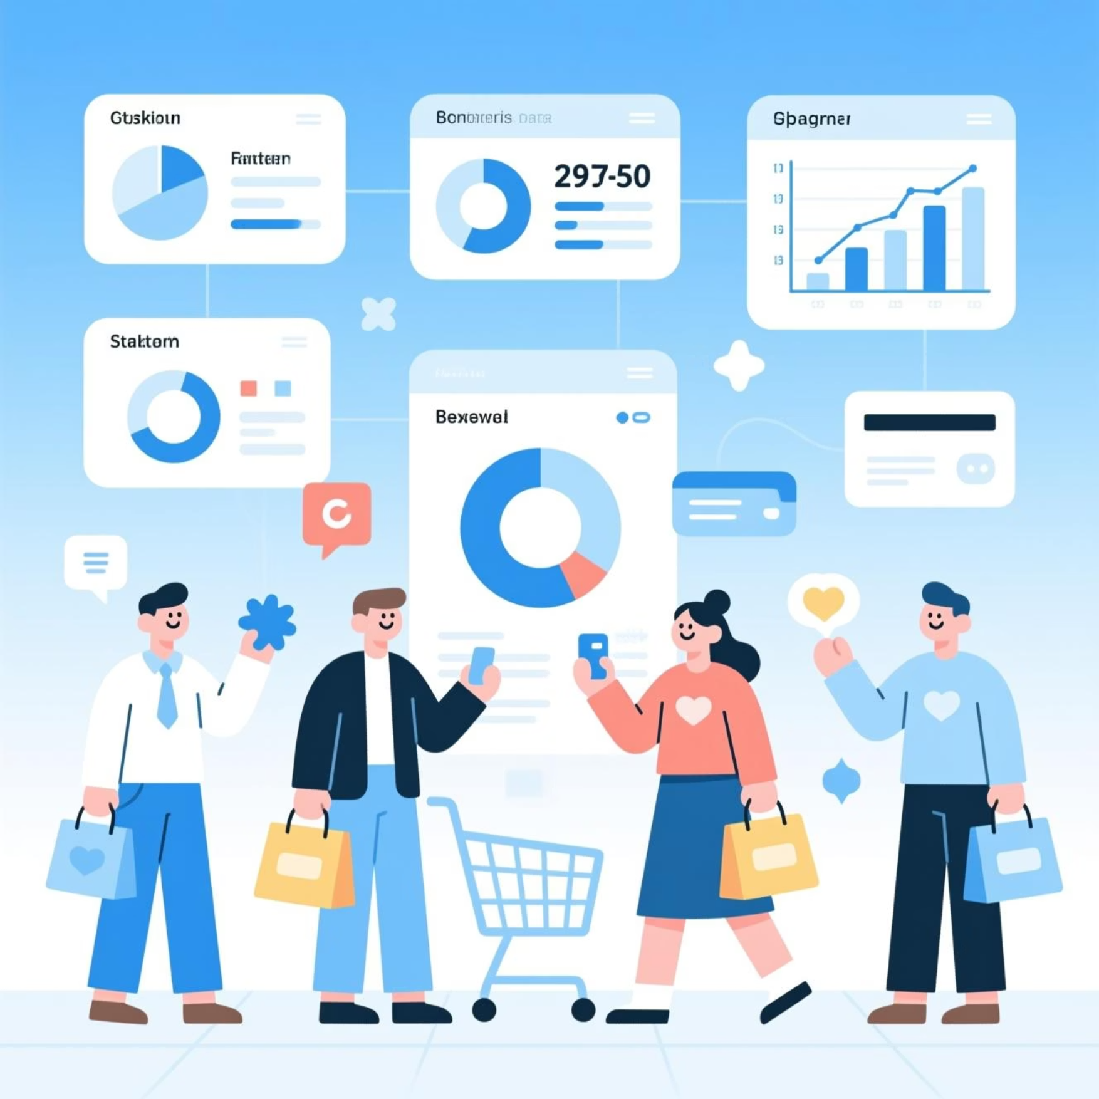
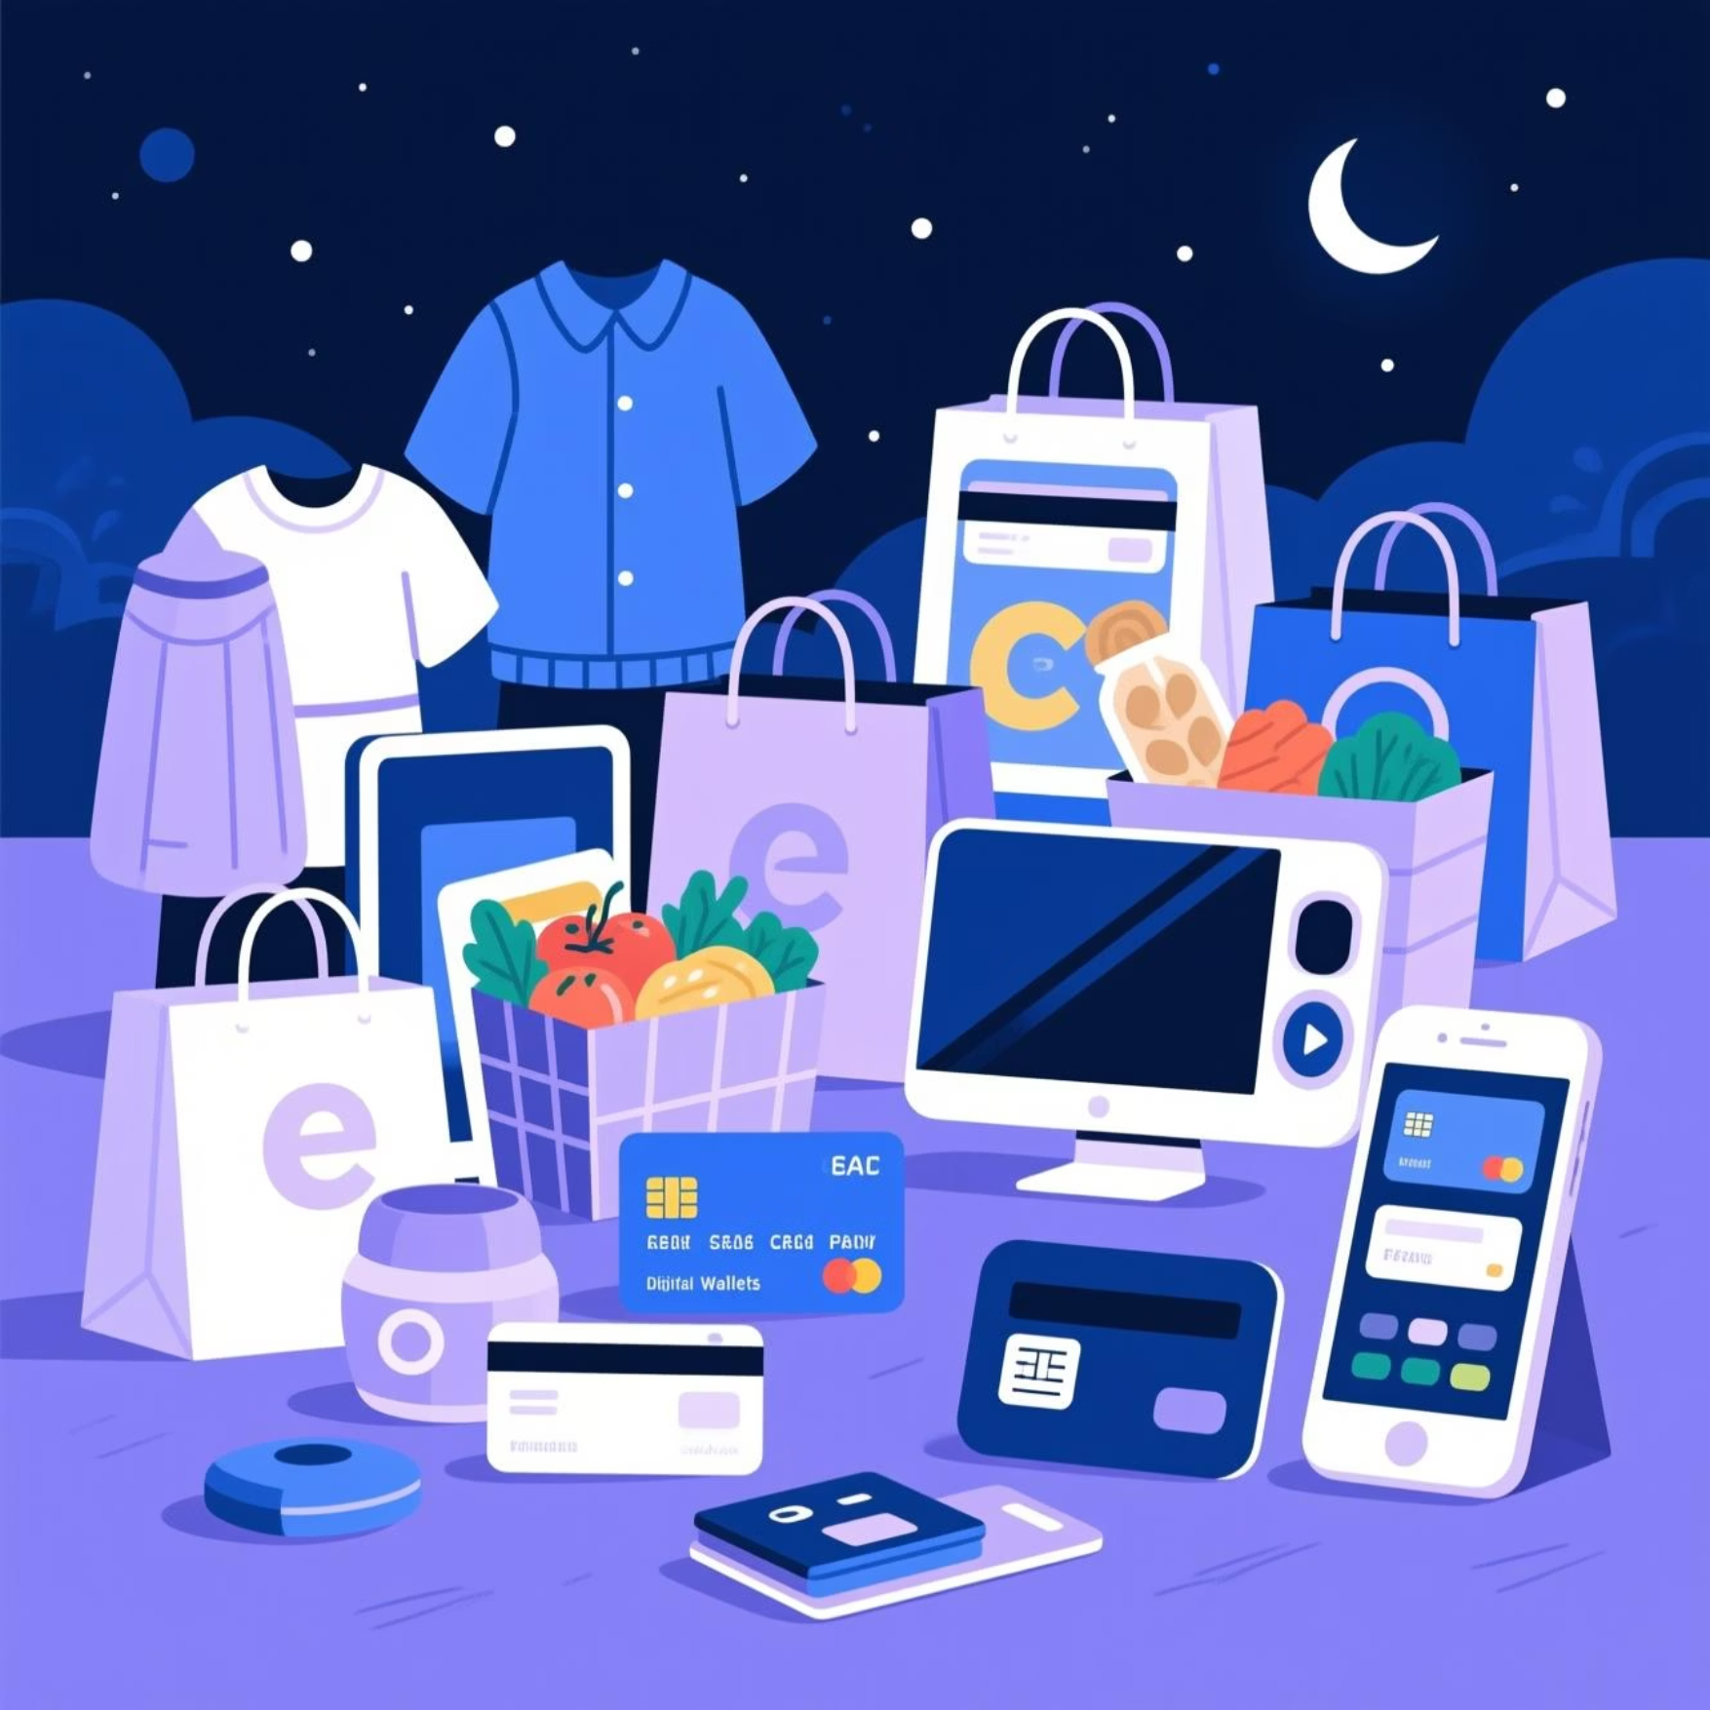
Dataset Description: Unpacking the Customer Data
Dataset Overview
Key Attributes Analyzed
Our analysis is built upon a robust dataset comprising approximately 3,900 customer records from U.S. retail shopping. This rich data provides a comprehensive view of diverse shopping behaviors.
Demographics: Age, Gender
Transaction Details: Purchase Amount (USD), Category
Behavioral Patterns: Season, Location, Discount Applied
Payment & Loyalty: Payment Method, Previous Purchases, Purchase Frequency

Slide 4
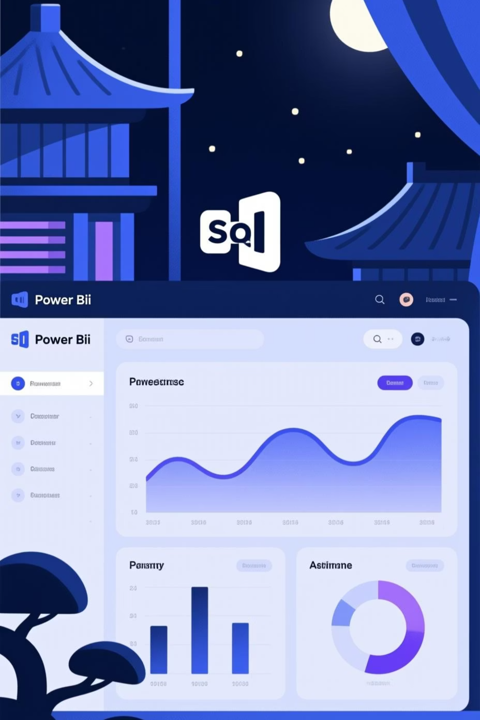






Tools & Technologies: Driving Insights
SQL
Power BI
For efficient data extraction and in-depth analytical queries.
Enabling interactive dashboards and compelling data visualizations for easy interpretation.
MS Word / PPT
Essential for comprehensive documentation and impactful presentations.
Why Power BI? Its intuitive interface and powerful visualization capabilities make it ideal for transforming complex data into actionable business insights.

Slide 5

Key Performance Indicators (KPIs) Overview
Our dashboard provides a quick, high-level snapshot of critical business health metrics, giving immediate insight into customer activity and overall performance.
3,900
$1.5M
$385
Total Customers
Total Revenue
Avg. Purchase Amount
A substantial base to analyze diverse shopping behaviors.
Reflecting the overall financial scale of customer transactions.
Indicator of typical spending per customer transaction.

Slide 6
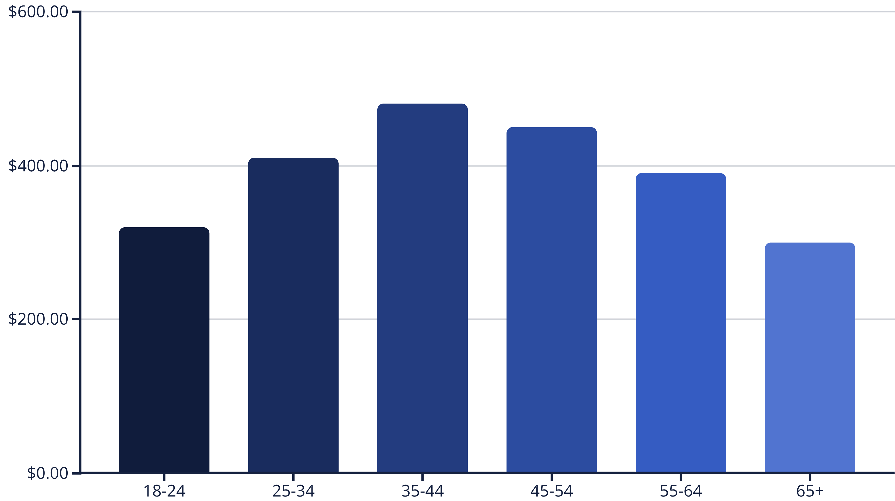
Age-wise Spending Analysis
Key Insight: Middle-aged customer groups (35-44) exhibit the highest average spending, indicating a strong potential for premium offers and loyalty programs.
Grouping customers by age reveals distinct spending patterns, vital for tailored marketing efforts.

Slide 7
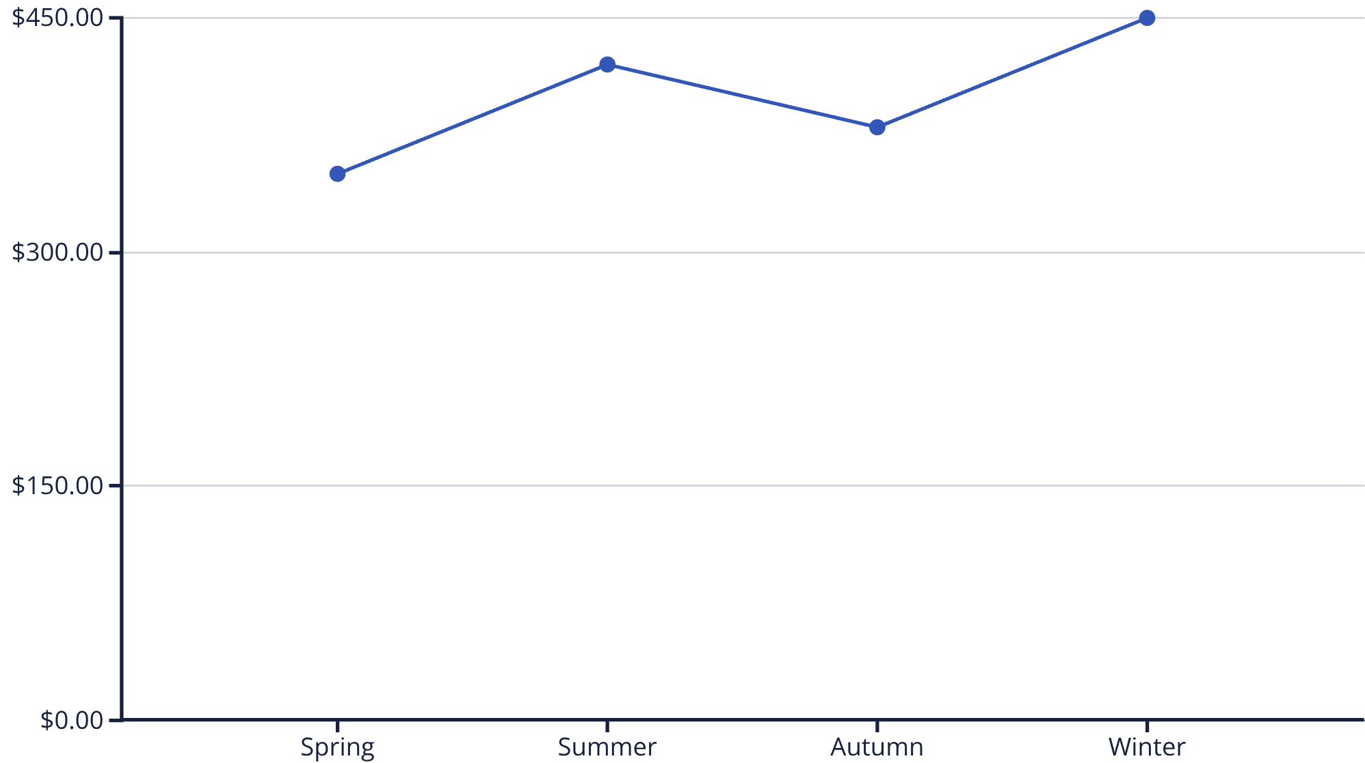
Seasonal Spending Trends
Analysis Performed
Examined the average spending patterns across various seasons to uncover fluctuations in customer purchase behavior.
Key Insight: Customer spending peaks during Winter, followed by Summer. These seasonal insights are invaluable for strategic planning of inventory and targeted marketing campaigns.

Slide 8






Customer Segmentation (Clustering)
Customers are segmented into distinct groups based on their purchase behavior, enabling highly targeted and effective marketing strategies.
Medium-Value Customers
Consistent but moderate spending, with potential for growth.
High-Value Customers
Frequent purchasers with high average transaction values.
Low-Value Customers
Infrequent purchases or lower average spending, often price-sensitive.
Purpose of Segmentation
Deepen understanding of diverse customer types
Develop personalized marketing campaigns
Optimize resource allocation

Slide 9

Business Insights & Recommendations
Key Insights Derived
Actionable Recommendations
Revenue Drivers: High-value customers are pivotal, contributing most significantly to overall revenue.
High-Value: Implement exclusive loyalty programs and personalized experiences.
Medium-Value: Create targeted offers and engagement strategies to upsell and increase frequency.
Spending Power: Middle-aged demographics represent a segment with consistently high spending patterns.
Low-Value: Utilize strategic discounts and promotions to incentivize purchases and boost retention.
Behavioral Shifts: Distinct seasonal trends heavily influence customer buying behavior and average purchase value.
Better Customer Understanding
1
Improved Targeting
2
Increased Business Value
3

